Slide 1
CBHA Presents Growing Yourself, Your Team and the Organization Presenter Mark Sanders, LCSW, CADC

Slide 2
12 Things Great Leaders Do

Slide 3
They teach

Slide 4
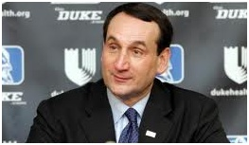
“If you only lead by example, you’re selfish! You are saying to the people you lead, be like me. Great leaders talk, they teach.” Coach K Duke University

Slide 5
They focus on the fundamentals first.

Slide 6
“One of the first things the Military does is teach you how to shine your shoes. Your feet are your foundation. If you start off with a weak foundation, it is hard to build from there” Shoe Repair Shop Owner Anchorage, Alaska

Slide 7
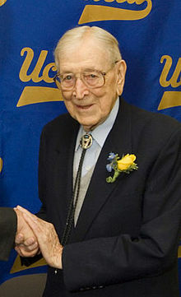
”The first thing I did at the beginning of each season was teach Hall of Famers Kareem Abdul Jabar, Bill Walton & their teammates how to properly put on a sock and shoe. If you get that wrong, you might get everything wrong.” John Wooden UCLA Hall of Fame Basketball Coach

Slide 8
They demonstrate long term honesty.
“A study of workers on all 7 continents reveals
that honesty is the number one leadership
quality that employees would willingly follow.”

Slide 9
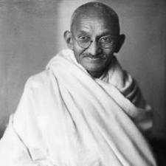
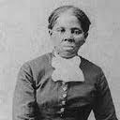
They demonstrate courage
Ghandi Harriet Loretta
Tubman

Slide 10
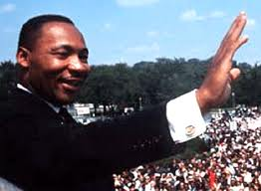
They have a clearly articulated vision.
“Where there is no vision the people
shall perish.”
Jesus Christ
Dr. Martin Luther King, Jr.
“I have a dream.”

Slide 11
“They have the ability to engage
others in a shared vision.”
“Great managers focus on motivating
employees by focusing on their individual
uniqueness. Great leaders motivate
others by focusing on their shared
similarities.”
Harvard Business Review

Slide 12
They selectively show their weaknesses.
Harvard Business Review
“No one wants a perfect supervisor.”
Vanessa Williams Church

Slide 13
The weakness should not be something that makes people think you are incapable of leading
It offers protection. If you don’t show one they will invent one for you

Slide 14
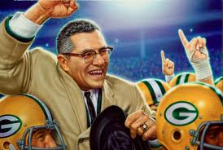
They demonstrate humility combined with a strong will to succeed.
“The dictionary is the only place that
success comes before work.”
Vince Lombardi

Slide 15
”In reading articles and quotes from managers who lead companies from Good to Great, they rarely use the word ‘I’ compared to other leaders. They also have a tenacious desire to succeed.” Jim Collins From Good to Great

Slide 16
They practice acts of self-care.

Slide 17
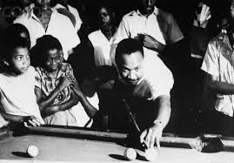

Slide 18
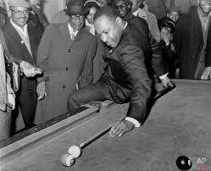

Slide 19
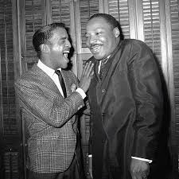

Slide 20
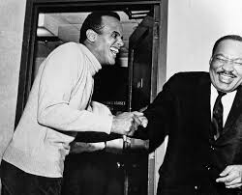

Slide 21
They delegate effectively.

Slide 22
6 Degrees of Delegation
1st degree: Look in to the problem. Report the facts back to me, and I’ll decide what to do
2nd degree: Look into the problem. Let me know alternative actions, including pros and cons of each, and recommend one for my approval.

Slide 23
6 Degrees Continued
3rd degree: Look into the problem. Let me know what you intend to do. Don’t take action until we discuss it.
4th degree: Look into the problem. Let me know what you intend to do; go ahead and do it unless you hear from me.

Slide 24
6 Degrees Continued
5th degree: Look into the problem. Take action; let me know what you did.
6th degree: Look into the problem. Take action; no contact with me is necessary.

Slide 25
They evaluate themselves with a desire to grow.

Slide 26
Why Would Anyone Want to be Led by You?

Slide 27
6 Levels of Leadership From Appointment to Transcendence Where Are You?
Level One: Appointment
The only influence you have at this level comes with the title.
May lead by intimidation.
Workers do only what they are required to do.
Morale may be low.

Slide 28
6 Levels of Leadership Continued
Level Two: Relationship
The relationship influences what workers do, not just regulations.
The heart is involved in this level of leadership.
People work with you not simply out of obligation…because they want to.

Slide 29
6 Levels of Leadership Continued
Level Three: Productivity
People follow because of what you have done for them and the organization.
Productivity is high.
Morale is high.
Workers’ needs are being met.
You individualize your supervision.
Your team works together to accomplish a purpose.
Your team is results-oriented.

Slide 30
6 Levels of Leadership Continued
Level Four: People Development
You empower others.
You develop other leaders.
You provide mentorship.
Workers demonstrate a great deal of loyalty because of how much you have helped them grow.

Slide 31
6 Levels of Leadership Continued
Level Five: Respect/Statesperson
You have spent many years molding and mentoring other leaders.
You have demonstrated years of integrity.
People accept your leadership because of who you are and what you represent.
At this stage leading is easier.
The organization achieves more because of your leadership.

Slide 32
6 Levels of Leadership Continued
Level Six: Transcendence
You are strong in Levels 2-5.
Heart leadership
Self-actualization
Absence of fear
No need to hide behind ism’s.
Lead through the law of invisibility.
Workers are willing to make great sacrifices.

Slide 33
6 Levels of Leadership Continued
Take a moment to rate yourself. ________
What would you have to change, personally or professionally, to move to the next level as a leader?

Slide 34
They build team unity.

Slide 35
Benefits of Team Cohesion
1. Built-in support
2. Greater productivity
3. Increased morale
4. Lower turnover
5. Greater client progress

Slide 36
Benefits of Team Cohesion Continued
6. Less burnout and organizational stress
7. Greater job satisfaction
8. Greater quality of life
9. Additional leverage in keeping work
performance high
10. Encouragement

Slide 37
Data Gathering
Focus groups
Anonymous questionnaire
Individual sessions

Slide 38
Questions
What do you like most about the work you do?
What are the primary problems that exist in your department?
Why is the department having these kinds of problems?
What keeps you personally from being as effective as you can be?

Slide 39
Questions Continued
What changes would make your department more effective?
What topics should be covered in the Teambuilding session and why?
What results would you like the session to
achieve
What would need to occur in order for you to feel that the session was a success?

Slide 40
7 Questions That Can Guide a Teambuilding Session
What are we doing well as a team that needs to continue?
What stops us from being as effective as we could be as a team?
What changes or additions could improve our team effectiveness?
What do you want team members to know about what it’s like to walk in your shoes?
What do you each need from each other in order to do your job better?

Slide 41
7 Questions Continued
6. What are the first 5 things we need to do
to improve our teamwork?
Who will do what?
When?
How will we measure success?
What will be signs that we are making
progress?
When should we follow up?
What should we do if there is no
progress?
7. What are we each prepared to do to help this team grow?

Slide 42
Other Activities to Support Teamwork
Use “team language” as a leader.
Make time for teambuilding.
Give team awards.
Add teamwork goals to annual reviews.

Slide 43
Other Activities Continued
Look for as many reasons to celebrate as possible.
Spend healthy time together.
The whole is greater than any of its parts—
discipline team members who refuse to do their work.

Slide 44
5 Reasons Employees Don’t Do Their Work
Don’t know how
Scared
No time
Can’t
Refuse

