Slide 1

Illinois Department of Human Services
Community Behavioral Healthcare Association
James T. Dimas, Secretary

Slide 2
Our Vision, Mission, Values, and
Motto
Our vision defines what we aspire towards.
Our mission statement defines what we are here to do.
Our core values are the guiding principles that shape our behavior and actions.
Our motto helps guide us, putting our mission and values into action every day.

Slide 3

Our Vision
Healthy independent people of Illinois
living in safe, strong communities

Slide 4
Our Mission
Strengthening Illinois by building up lives and communities

Slide 5
Our Core Values
Human Dignity
We believe self-sufficiency meets human needs in ways dependency cannot.
We want to serve people in the least restrictive way possible that promotes independence and relationships within the community.
We serve people where they are, with empathy, dignity, respect, and cultural competence.

Slide 6
Our Core Values
Teamwork
We work together so there is no wrong door/desk for our customers. We take personal responsibility for helping or connecting customers to the right person who can help.
We are accountable to each other for quality and results.

Slide 7
Our Core Values
Learning
We make decisions based on evidence and data and change our assumptions when the facts don’t support them.
We value business processes that are simple, efficient, and user friendly.

Slide 8
Our Core Values
Integrity
We are good stewards of public resources and prioritize spending that provides the greatest social and economic benefits for the people of Illinois.
We conduct ourselves with integrity and honesty and will swiftly act against any behavior that enriches a person at the expense of public trust.

Slide 9
Our Motto
Committed to treating people the way we wish to be treated

Slide 10
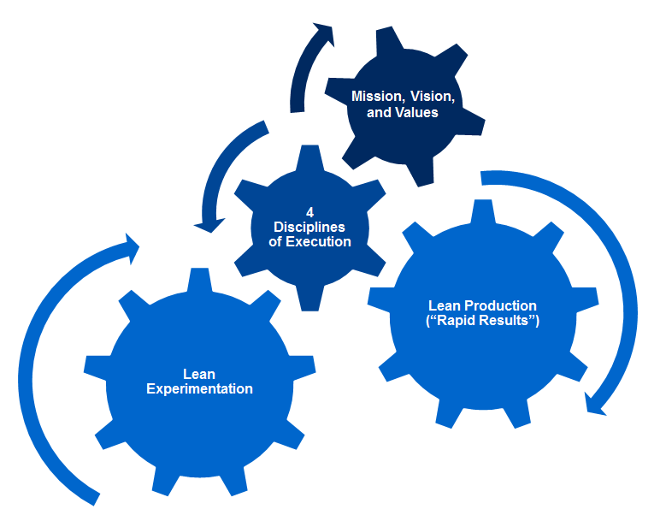
Strategic Alignment

Slide 11
The 4 Disciplines
1
2
3
4
Focus on the Wildly Important
Act on Lead Measures
Keep a Compelling Scorecard
Create a Cadence of Accountability
Focus on the Wildly Important. Teams are limited to no more than 1-2 goals. Defined a X to Y by When.
Act on the Lead Measures. Identify a small set of lead measures that are predictive and influenceable
Keep a Compelling Scoreboard. Design for the players (not coaches) for simplicity and visibility
Create a Cadence of Accountability. Meet weekly to account, review scoreboard and plan
Adapted from The 4 Disciplines of Execution by Chris McCheseny et.al. Franklin-Covey 2012

Slide 12
Forensic Wig: Reducing the wait time
WIG, Lead Measures, Work to Date

Slide 13
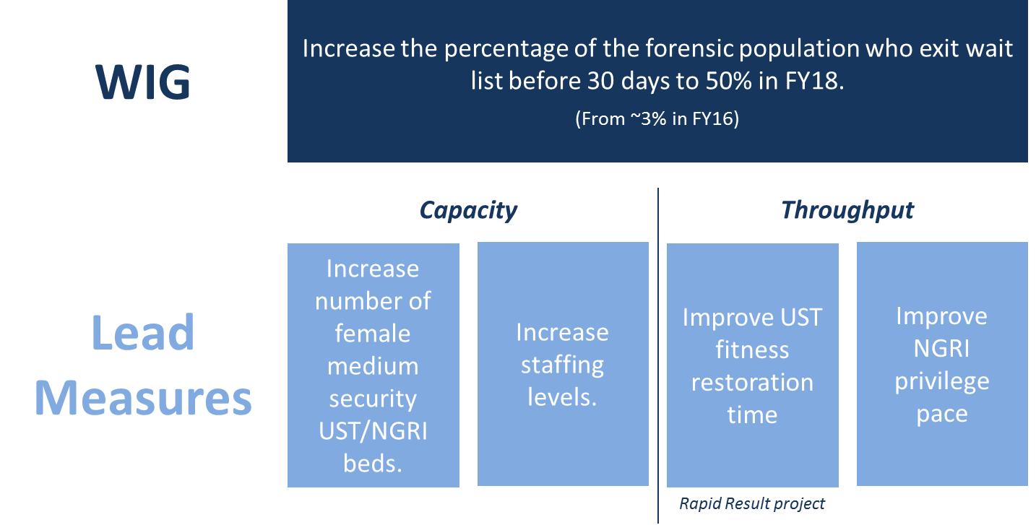
Forensic WIG and Lead Measures
Rapid Results project

Slide 14
Wait Time Progress vs. Target Pace
For the month of November through the 26th, 26% of admissions from the wait list (13 of 50) have been in fewer than 30 days, well ahead of the target pace (21%).
Percent of Cases Exiting the Forensic Wait List in < 30 Days:
Actual and Target Trajectory
Target: 50%
Last Performance Review

Slide 15
Lag Measure: Admissions with < 30 Day Wait
Admissions per month have increased since June and appear to be flattening in the 55-60/month range.
Forensic Admissions, by Wait Time

Slide 16
UST Restoration Time Rapid Results
DMH has been working on a Rapid Results project around UST restoration time.
Rapid Results Outputs
Developed a Fitness Restoration Directive (in approval process)
  Directive establishes benchmarks with the goal of restoration in 90 days or less
Began mandatory training on the Directive in October
  Elgin, Alton, McFarland completed
  Chester training the week of 12/4
Started tracking all UST units’ LOS times (admissions to report to the court of restoration) – individual / statewide data is forthcoming
Included monthly reporting of LOS data to central office in the Directive

Slide 17
Hospital Capacity Increase / Optimization
To better meet the needs of individuals on the wait list, DMH repurposed existing beds in two hospitals and added new capacity in a third.
Alton
Chicago Read
Elgin
Goal: Repurpose 22 medium security beds.
Steps:
Transferred existing patients to other units
Completed physical renovations
Hired staff
Reopening unit to females on 12/18
Goal: Increase minimum secure bed capacity by 18.
Steps:
Assessed patients for minimum security
Completed physical renovations
Hired staff
Received 18 stepped down patients from Elgin
Goal: Repurpose 25 medium security beds.
Steps:
Stepped down 18 patients (transferred to Chicago Read)
Have admitted 29 females to date from the forensic waitlist

Slide 18
Civil WIG: super utilizers at madden
WIG, Lead Measures, Work to Date

Slide 19
Madden Super Utilizer Background
In the twelve months comprising FY16, 106 individuals were admitted to Madden three or more times, accounting for 416 total admissions.
These individuals comprised 4% of the total unique individuals admitted to Madden in that time period, but accounted for 15% of Madden’s 2,860 admissions (and 8% of the 5,125 statewide State-Operated Hospital admissions).
Further historical analysis found that these 106 individuals account for nearly 1,400 lifetime admissions to Madden and that the majority of these individuals had extensive histories with Madden admissions, some as far back as the early 1990s.
  A common factor among almost all of these individuals was lack of enrollment in Medicaid (or other insurance).

Slide 20
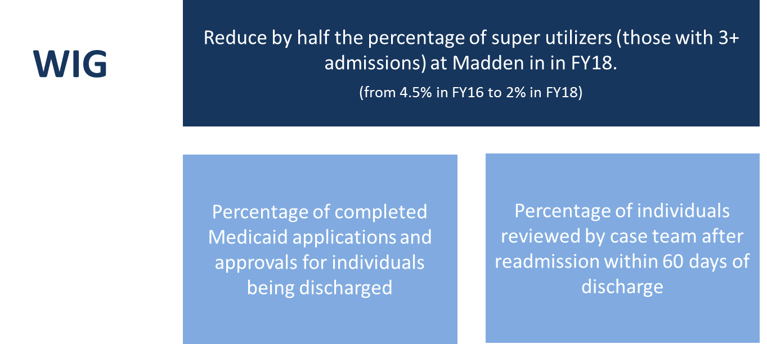
Civil WIG and Lead Measures

Slide 21
Super Utilizer Rate: 12-Month Rolling
57
of these individuals had 3+ admissions in that same time period
2,218
2.56%
unique individuals admitted to Madden in the past 12 months (11/29/16-11/28/17)
12-month rolling super utilizer rate
2,161
had < 3 admissions in the past 12 months

Slide 22
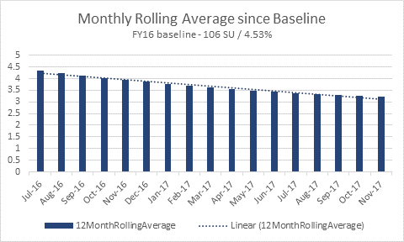
12-Month Rolling Average Progress
WIG Start: 4.53%
11/28: 2.56%

Slide 23
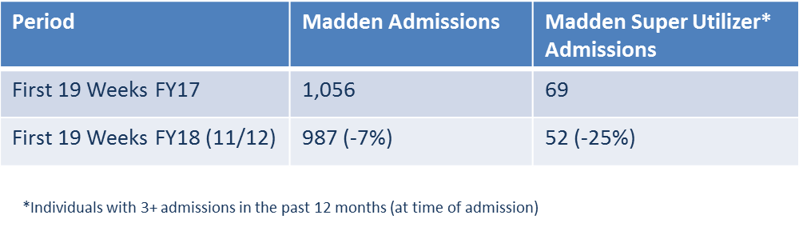
FY16-17 Super Utilizer Comparison (through first 19 weeks of FY)
In the first 19 weeks of FY18 (through 11/12), there were 7% fewer admissions to Madden and 25% fewer super utilizer admissions to Madden than in the first 19 weeks of FY17.

Slide 24
Applications & Approvals, FY18 to Date
*Includes individuals already receiving Medicaid

