Slide 1
45th Annual Conference
Hyatt Regency Woodfield
Schaumberg, IL
December 11-12, 2017

Slide 2
Community Behavioral Health Workforce Crisis
Illinois ranks 41st in the nation for mental health service coverage provided to children, with only 45% of children receiving necessary care.
85 of 102 counties in Illinois having areas designated as Health Professional Shortage Areas for Mental Health Services.
Wait times to see a psychiatrist in the Illinois community mental health system can range from four to six months.
Illinoisans are unable to adequately access community based behavioral health services due to the behavioral health workforce shortages.
The state has failed to implement an effective community behavioral health workforce strategy to address the state’s community behavioral health workforce crisis

Slide 3
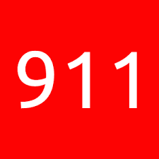
MENTAL HEALTHCARE EMERGENCY HR 711
House Resolution 711 is a 911 to lawmakers. It seeks to illustrate the immensity and urgency of the community behavioral health workforce problem in Illinois and to highlight the need for the legislature to resolve it.

Slide 4
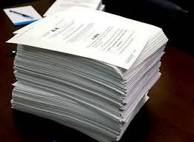
MENTAL HEALTHCARE EMERGENCY HR 711
Adopt a comprehensive legislative package to address the community mental health and substance disorder workforce and behavioral healthcare access crisis in Illinois.

Slide 5
MENTAL HEALTHCARE EMERGENCY HR 711
House Sponsors Rep. Lou Lang, Tom Demmer, Deb Conroy, Steven A. Andersson and Sara Feigenholtz
Sponsors are a Bipartisan Slate of Legislative Leaders

Slide 6
Please Contact Your State Representatives To Support HR 711
Please educate your legislators and urge them to sign on as co-sponsors
Thank you

